Slide 1
Lecture 10
Threads

Slide 2

Single and Multithreaded Processes

Slide 3
Benefits
Responsiveness
Resource Sharing
Economy
  in Solaris, creating a process is about 30 times slower than is creating a thread
Utilization of multiprocessor architectures

Slide 4
User vs. Kernel Threads
User Threads
Thread management done by user-level threads library:
  POSIX Threads (Pthreads)
  Windows XP Threads
  Linux Threads
  Java Threads
Kernel Threads
Supported by the kernel: Windows 2000 +, Solaris, Linux, Mac OS X

Slide 5
Multithreading Models
Many-to-One
One-to-One
Many-to-Many

Slide 6

Many-to-One
Many user-level threads mapped to single kernel thread
Examples:
  Solaris Green Threads
  GNU Portable Threads

Slide 7

One-to-One
Examples
  Windows NT/XP/2000
  Linux
  Solaris 9 and later

Slide 8

Many-to-Many Model
Allows many user level threads to be mapped to many kernel threads
Allows the operating system to create a sufficient number of kernel threads
Solaris prior to version 9
Windows NT/2000 with the ThreadFiber package

Slide 9

Two-level Model
Similar to M:M, except that it allows a user thread to be bound to kernel thread
Examples
  IRIX
  HP-UX
  Tru64 UNIX
  Solaris 8 and earlier

Slide 10
Thread Pools
Create a number of threads in a pool where they await work
Advantages:
  Usually slightly faster to service a request with an existing thread than create a new thread
  Allows the number of threads in the application(s) to be bound to the size of the pool

Slide 11
Pthreads
A POSIX standard API for thread creation and synchronization
API specifies behavior of the thread library, implementation is up to development of the library
Common in UNIX operating systems (Solaris, Linux, Mac OS X)

Slide 12
Windows Threads
One-to-One mapping.
Each thread contains: id, register set, separate user and kernel stacks, private data storage area.
The register set, stacks, and private storage area are known as the context of the threads
Windows Vista enhancements: thread pool significantly enhanced to improve reliability, performance, and API simplicity.

Slide 13
Linux Threads
Linux refers to them as tasks rather than threads
Thread creation is done through clone() system call
clone() allows a child task to share the address space of the parent task (process)

Slide 14
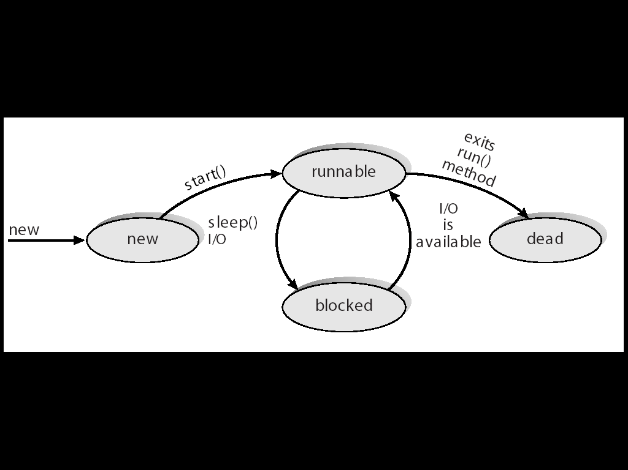
Java Threads
Java threads are managed by the JVM
Java threads may be created by:
  Extending Thread class
  Implementing the Runnable interface

